Slide 1
Image Generation using Deep Convolutional -GAN
NAME: Vigneshwar S N
NM-ID: au711721243123
KGiSL Institute Of Technology
3/21/2024 Annual Review

Slide 2
PROJECT TITLE
Generate Images using Deep Convolutional -GAN
3/21/2024 Annual Review

Slide 3


AGENDA
Problem Statement.
Project Overview.
End Users.
Our Solution and Proposition.
Key Features.
Modelling Approach
Results and Evaluation
3/21/2024 Annual Review

Slide 4

PROBLEM STATEMENT
Deep Convolutional Generative Adversarial Network (DC-GAN) architecture optimized for generating high-fidelity images. Keep in mind that implementing and training a DC-GAN requires a solid understanding of deep learning concepts and frameworks like TensorFlow or PyTorch.
3/21/2024 Annual Review

Slide 5

PROJECT OVERVIEW
Dataset: Choose and preprocess a dataset (e.g., CIFAR-10) with normalized pixel values and standardized image sizes.
Network Design: Create generator and discriminator networks with convolutional layers and activation functions like Leaky ReLU and Tanh.
Training: Train the DC-GAN adversarially, updating generator and discriminator weights iteratively.
Optimization: Adjust hyperparameters and architectures to improve convergence and image quality.
Evaluation: Assess generated images qualitatively and quantitatively using metrics like FID and IS, and gather human feedback for subjective evaluation.
3/21/2024 Annual Review

Slide 6

WHO ARE THE END USERS?
Educators and Researchers: They can utilize generated images for teaching purposes, illustrating concepts in textbooks, or conducting research in fields like computer vision and artificial intelligence.
Fashion Industry Professionals: Fashion designers and retailers can use generated images for showcasing clothing designs, creating virtual fashion shows, or generating synthetic models for online catalogs.
Medical Professionals: Medical researchers and practitioners can utilize generated images for training and validating diagnostic algorithms, simulating medical scenarios, or visualizing anatomical structures.
Environmental Scientists: Researchers studying environmental phenomena such as climate change, biodiversity, or landscape ecology can use generated images to simulate natural landscapes, ecosystems, or weather patterns.
Social Media and Content Creators: Influencers, bloggers, and content creators can incorporate generated images into their social media posts, blog articles, or digital content to enhance visual appeal and engagement.
Product Designers and Engineers: Companies involved in product design and manufacturing can utilize generated images for prototyping, virtual testing, and marketing visualization of products and prototypes.
3/21/2024 Annual Review

Slide 7

YOUR SOLUTION AND ITS VALUE PROPOSITION
SOLUTION: Our approach harnesses DC-GANs to autonomously generate lifelike images that closely mirror those found in a specified dataset. Through repeated training iterations, our system adeptly learns to craft images that exhibit realism akin to authentic photographs.
VALUE PROPOSITION:
Our solution offers a compelling value proposition by leveraging AI-driven image generation to produce lifelike images suitable for diverse applications such as art, design, and entertainment. With streamlined efficiency and automation, we save time and resources in visual creation. Our versatile approach spans various image types and scenarios, driving innovation and contributing to advancements in AI technology.
3/21/2024 Annual Review

Slide 8

THE WOW IN YOUR SOLUTION
Our solution stands out for its ability to create exceptionally lifelike images, driven by cutting-edge AI automation to ensure efficiency and premium outcomes. Whether it's portraits or scenic vistas, our versatile methodology caters to a wide range of demands. What truly sets us apart is our dedication to innovation, continually pushing the limits of image generation technology. With personalization as our cornerstone, we provide bespoke solutions tailored to suit the distinct needs of every user and industry. Experience the remarkable capabilities of our solution and join us in charting the course for the future of image generation.
3/21/2024 Annual Review

Slide 9
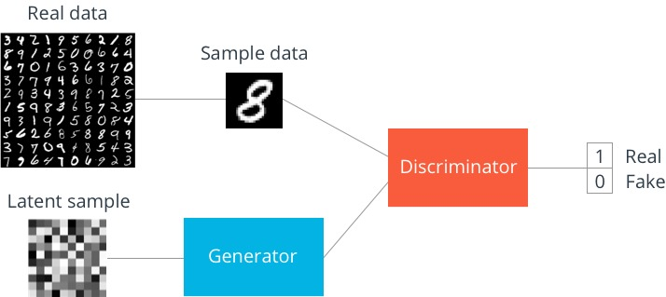
MODELLING
GENERATOR MODEL: It is Used to create fake images resembling digits.
DISCRIMINATOR MODEL: It is Used to distinguish real and fake images.
3/21/2024 Annual Review

Slide 10
RESULTS
Our project highlights the remarkable potential of employing DC-GANs for generating top-quality images. Following rigorous training, our model adeptly mimics the training dataset, preserving intricate details with precision. Its adaptability extends across a wide array of image categories, encompassing everything from facial portraits to sprawling landscapes, ensuring applicability in diverse contexts. By leveraging DC-GANs in novel ways, we propel the field of image generation forward, driving advancements in artificial intelligence.
DemoLink

